Slide 1
Non-parametric statistics

Slide 2
Motivation
Medical data often not so normally distributed
Questionnaires, only including patients above/below a certain threshold in the trial

Slide 3
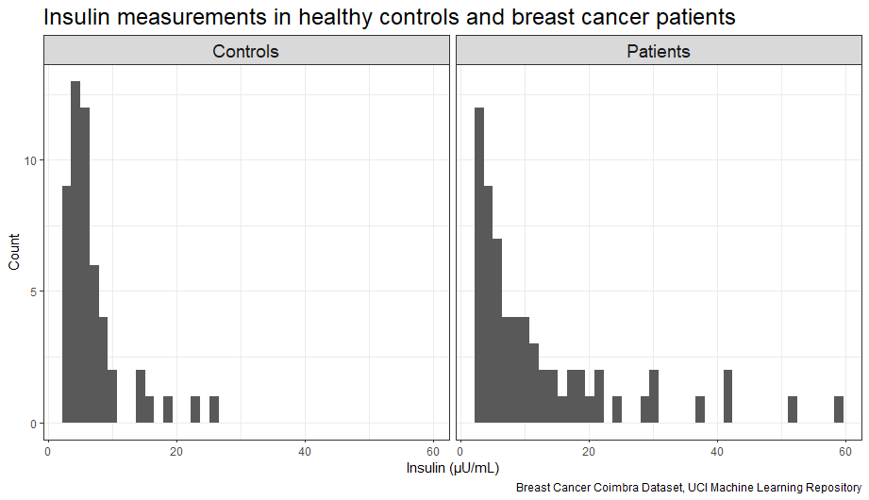
Simple Example
116 observations, 64 with breast cancer, 52 healthy controls

Slide 4
T-test for independent samples

